Slide 1
Summer co-writing week: Review-of-reviews
2023.07.15

Slide 2
Schedule?
9:00-15:00 from 17.07 (Monday) to 21.07 (Friday)
Friday afternoon: Off

Slide 3

Last year
The 1st joint work on a focal topic
(+) learning the process of a peer-reviewed article publication including scientific writing
(-) none of the topics fits to all
(-) only me as the first author

Slide 4
Achievements?
To establish the method, review-of-reviews and publish one article
To finish a draft of the 2nd chapter of your PhD theses (literature review)
(optional) To write a manuscript as the 1st author on the topic
Soft aspects
To boost your productivity by locking the schedule for one week
To work as a team

Slide 5
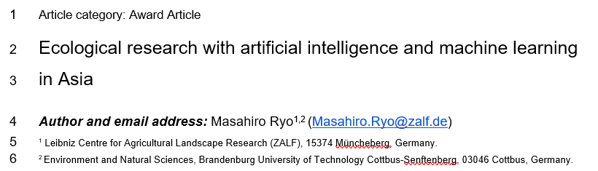
Key reference

Slide 6
steps
Topic discussion round table
Reviewing a narrow topic (if #review: order of 10-100)
Review-of-reviews (order of 1,000)
Review-of-top reviews (order of 10,000)
Read Ryo (2023) https://www.authorea.com/users/632731/articles/651420-ecological-research-with-artificial-intelligence-and-machine-learning-in-asia
Set up R with libraries for running the script in Ryo (2023)
Download the bibtex data and implement the analysis pipeline
Discuss and write for each point

Slide 7
Discussion points
Topic to study
Why review-of-reviews is needed
Analytical pipeline
Pros and cons of the method (e.g., efficiency, limitation)
Comparison to analyzing original articles (topic as element; article as element)
GPT for supporting our writing?

Slide 8
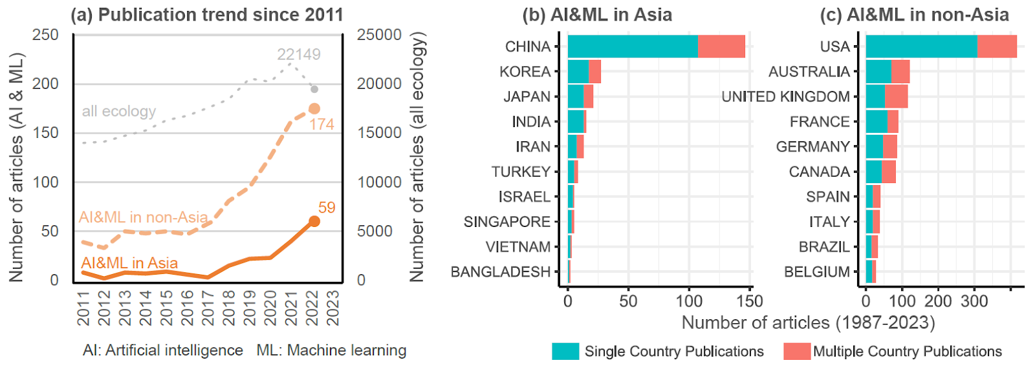
Publication trend
Total vs review
Historical vs recent country rankings

Slide 9
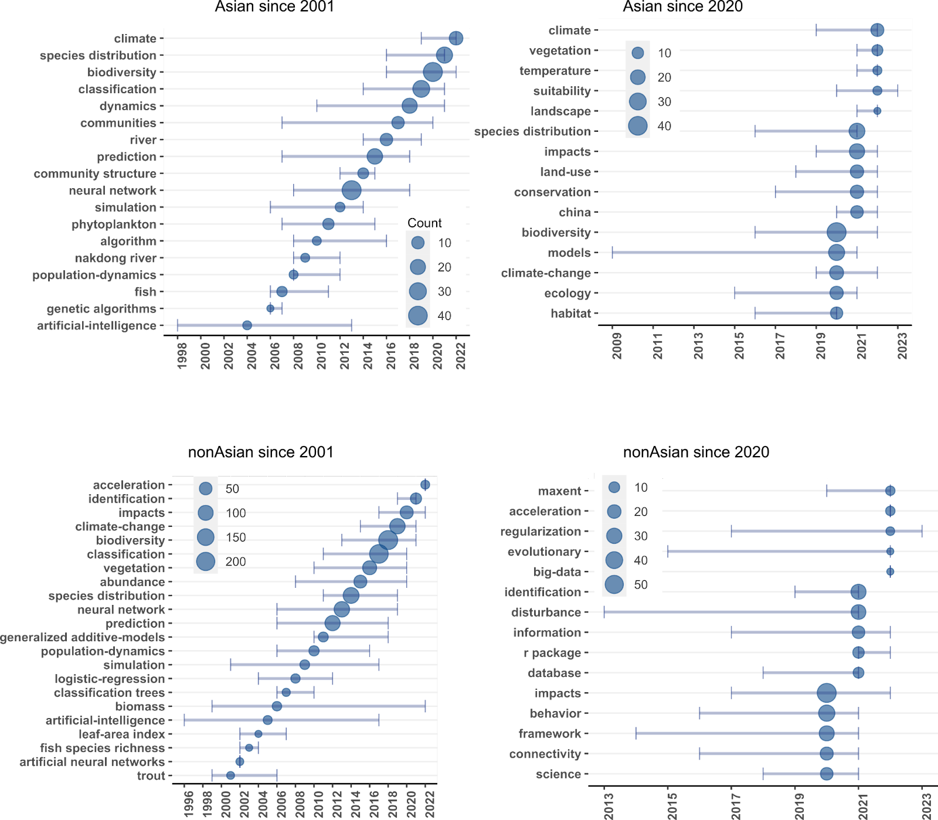
Keyword trend
Historical vs recent keyword trends
Author defined vs WoS defined keywords

Slide 10
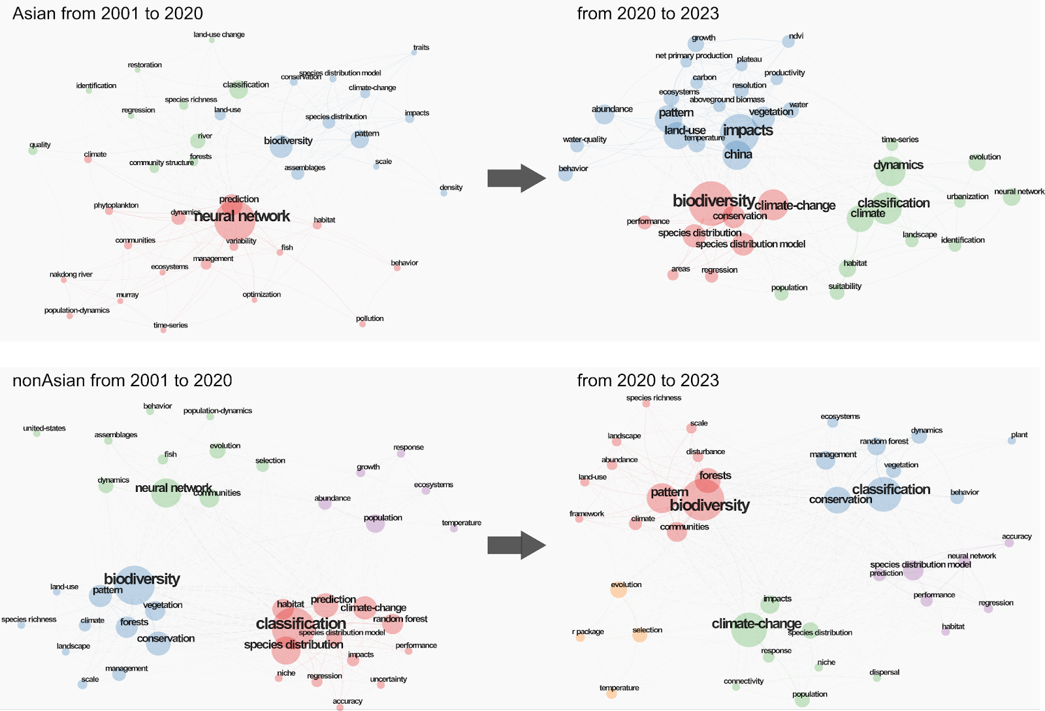
Keyword co-occurrence
Historical vs recent publications
Author-defined vs WoS
Clustering methods?

Slide 11
Any other analyses?

